Slide 1

Weekly Report
DAW Project

Slide 2
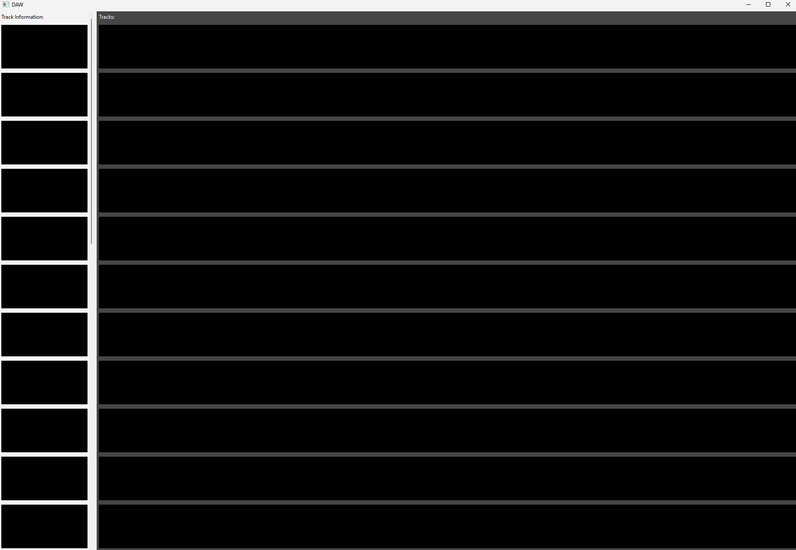

Progress on UI
DAW Project Report

Slide 3
Progress on file manager

Slide 4
Struggles this week
DAW project
Compiler issues
Backup file mishap
MIDI file reading
File manager issues

